Slide 1

Introduction to
Workflows and Provenance
Introduction to Computational Thinking and Data Science
Yolanda Gil
gil@isi.edu
CC-BY
Attribution
October 2016

Slide 2

These materials are released under a CC-BY License
https://creativecommons.org/licenses/by/2.0/
Please credit as: Gil, Yolanda (Ed.) Data Science for Non-Programmers. Information Sciences Institute, University of Southern California. 2016.
You are free to:
Share — copy and redistribute the material in any medium or format
Adapt — remix, transform, and build upon the material
for any purpose, even commercially.
The licensor cannot revoke these freedoms as long as you follow the license terms.
Under the following terms:
Attribution — You must give appropriate credit, provide a link to the license,
and indicate if changes were made. You may do so in any reasonable manner,
but not in any way that suggests the licensor endorses you or your use.
If you use an individual slide, please place the following at the bottom of each slide: “Credit: http://www.datascience4all.org/”

Slide 3
Workflows and Provenance
Workflows
Provenance
The WINGS workflow system

Slide 4
I. Workflows
Introduction to Computational Thinking and Data Science
Yolanda Gil
gil@isi.edu
Fall 2016

Slide 5
Workflows
Workflows
Computational workflows
Benefits of using workflows
Workflow systems

Slide 6
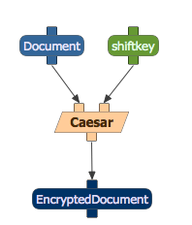
Programs as Black Boxes: Functions with Inputs, Outputs, and Parameters

Slide 7
Composing Functions
CompA
CompA
CompB
CompB
CompB

Slide 8
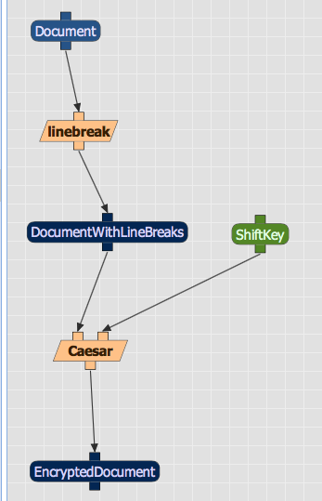
A Workflow is a Composition of Functions

Slide 9
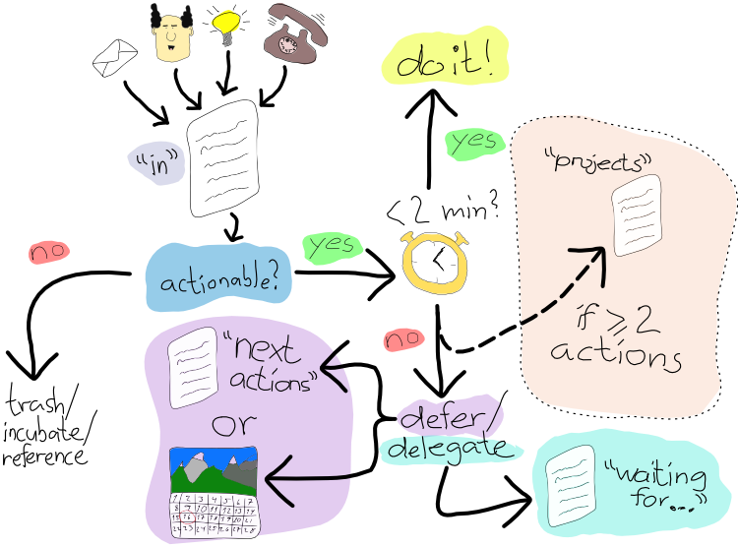
“Workflow” Is a Common Term to Denote Organized Activities
https://www.flickr.com/photos/atosorigin/11008571564

Slide 10
Many Meanings of Workflow
✗
Workflows of human activities
Eg, checking patient in hospital
Eg, scanning a document
Workflows of web services
Eg, integration of business services
Eg, accessing databases in biology
Workflows composed of programs
Eg, encrypt each sentence in a document
✗
✔

Slide 11
2. Computational Workflows

Slide 12
Computational Workflows
Workflow is represented as a graph of connected nodes
Nodes represent programs and data (alternatively)
Links represent how data flows from program to program (output to input)
Computational workflows are compositions of programs
No user interaction during execution
No cycles allowed!
Program1
Program2
DataB
DataE
Program4
Output
DataG
Input
DataA
Program3
DataC
DataF
Output
DataH

Slide 13


Not a Computational Workflow
Code1
Code2
Code3
DataA
DataB

Slide 14
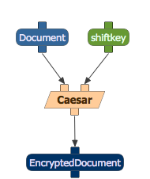
Workflow Component

Slide 15
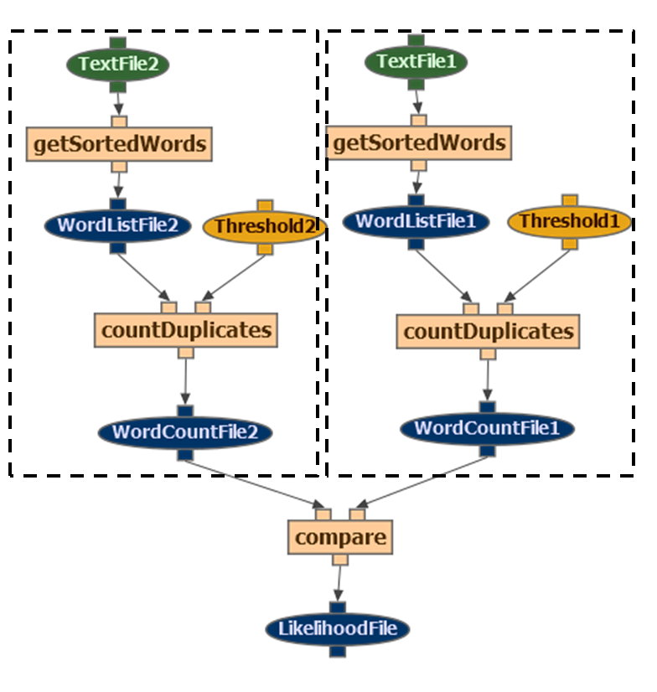
Example: Document Similarity

Slide 16
CLASS EXERCISE: Sketch a Workflow
Suppose you are buying tickets online for an event
Getting information about dates and times for the event
Reserving the seats
Paying for the tickets
Getting the tickets mailed to you

Slide 17
CLASS EXERCISE: Sketch a Workflow
Suppose you are buying tickets online for an event
Getting information about dates and times for the event
Reserving the seats
Paying for the tickets
Getting the tickets mailed to you
Your tasks:
Identify the services that you will be using
Identify the sequence of requests and responses that you will be asking from each service
Identify what inputs and outputs each service request will need to have
Sketch the information flow from service request to service request

Slide 18
3. Benefits of Using Computational Workflows

Slide 19
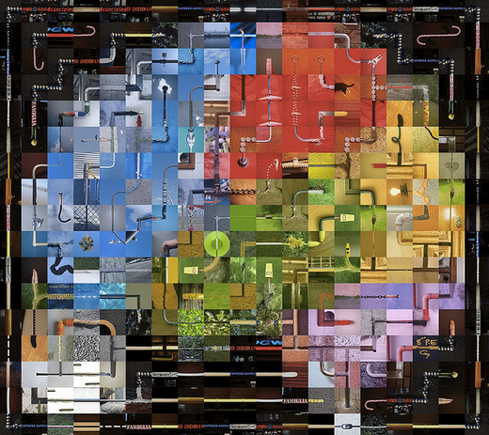
Benefits of Using Workflows
Simple programming paradigm
Modular assembly
Composing heterogeneous code
Abstraction
Data preparation steps
Data visualization steps
Documenting provenance: reproducibility
Automatic processing of multiple inputs
Large-scale processing
Facilitating communication across data science expertise areas
https://www.flickr.com/photos/genista/3432987963

Slide 20
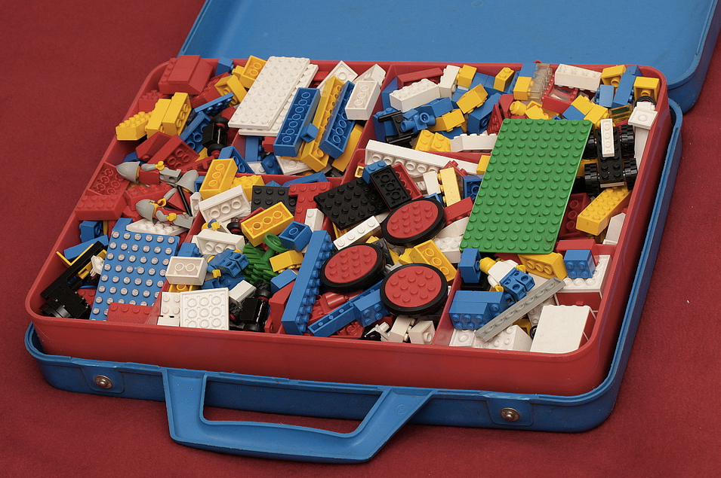
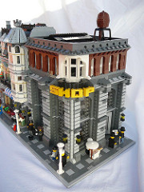
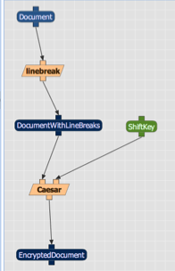
Simple Programming Paradigm
https://www.flickr.com/photos/pasukaru76/5571502641
https://www.flickr.com/photos/georgivar/5535049084

Slide 21
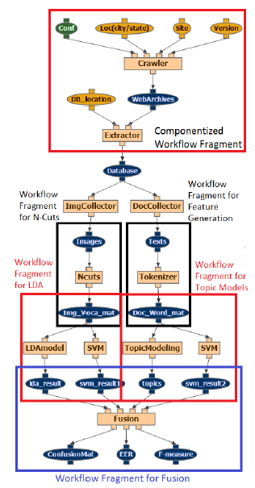
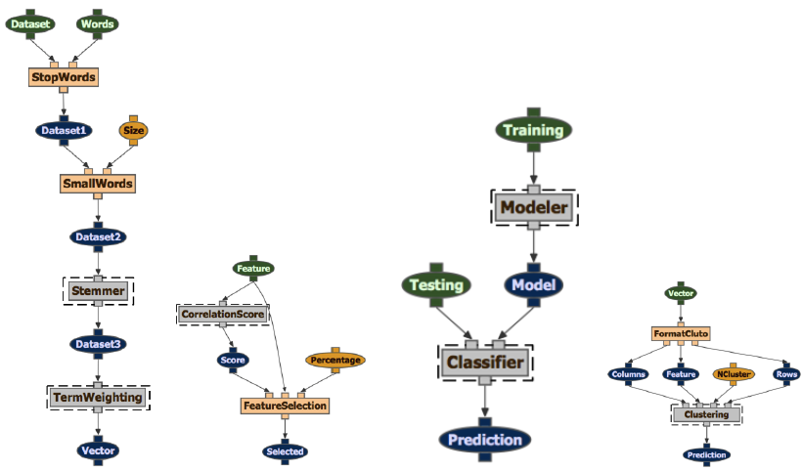
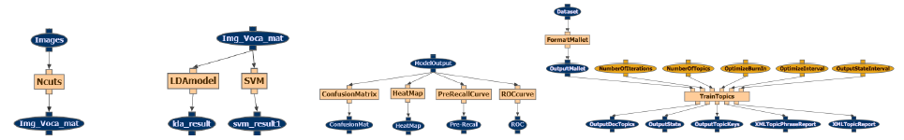
Modular Assembly
[Sethi et al MM’13]

Slide 22
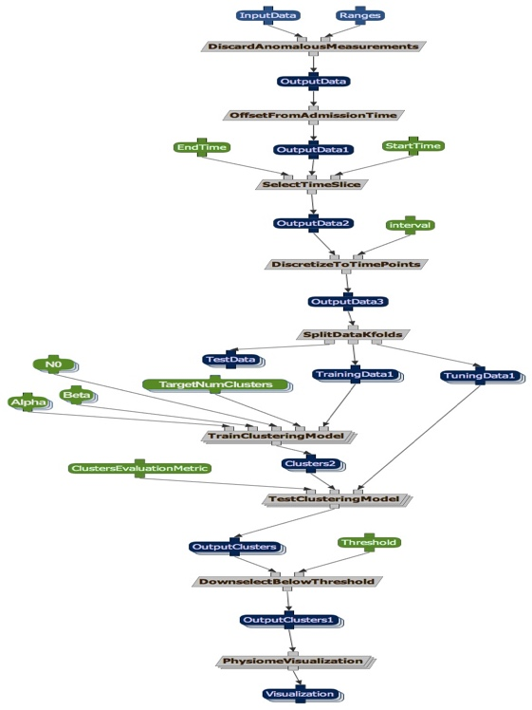




Composing Heterogeneous Code

Slide 23
Describing a Computation at Different Levels of Abstraction
METHODS
ALGORITHMS
IMPLEMENTATIONS
Correlation Scoring
Chi Squared
R CODE

Slide 24
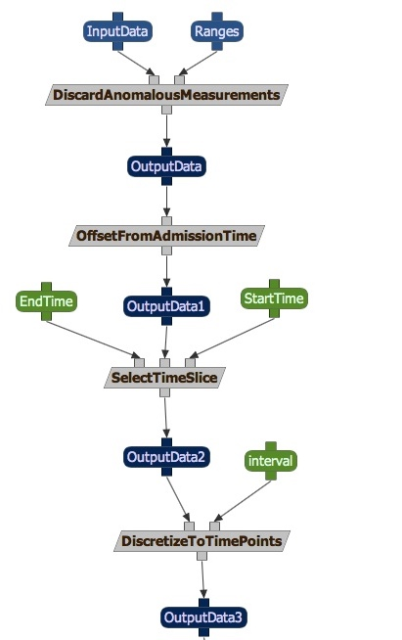
Include Data Preparation Steps
[Kale et al 2013]

Slide 25
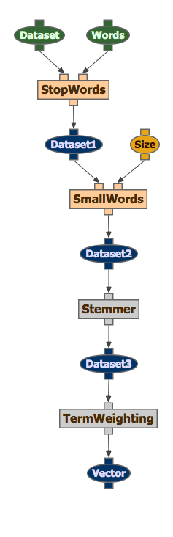
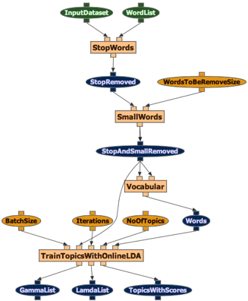
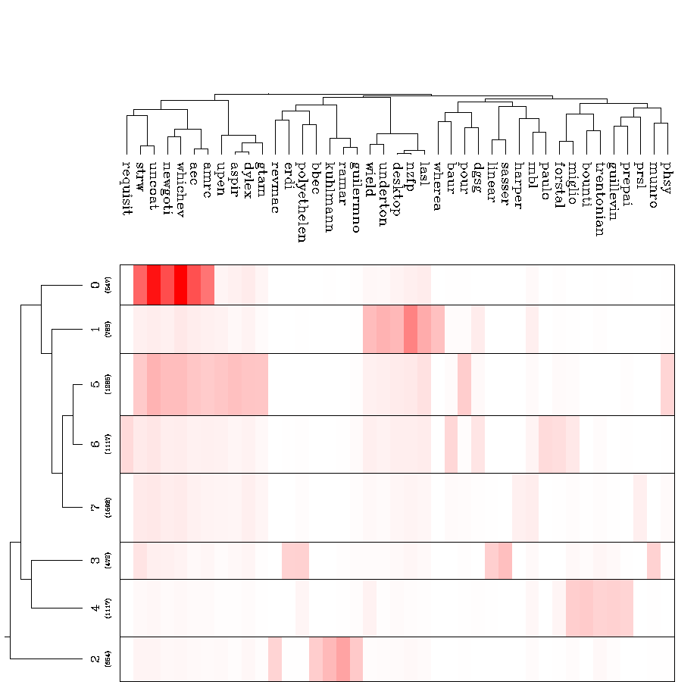
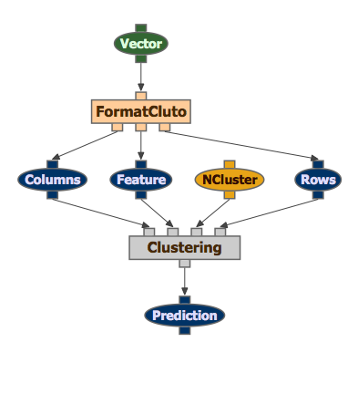
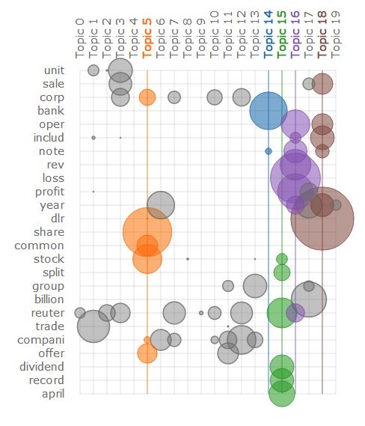
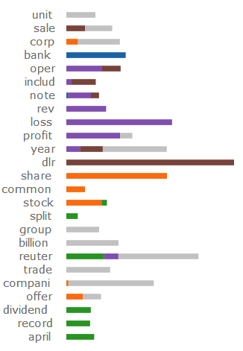
Include Data Visualization Steps

Slide 26
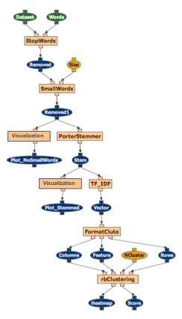
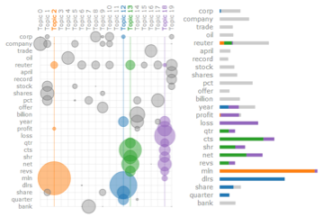
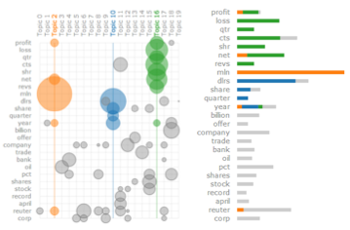
Intermediate Data Visualization Steps
Visualizations of intermediate results
Visualizations of final results
Termite LDA-based visualizations [Chuang et al 2012]

Slide 27
Documenting How Results Are Obtained: Provenance
Each time the workflow is executed, the system records the provenance of the results: what workflow was used, what its components were, what the input data was, and what values were assigned to the parameters.

Slide 28
Execution Records (Provenance) vs General Method (Workflow)
NYT Article 9/9/2016
Document
23
8
5
800
NYT Article 9/9/2016 - Encrypted
Encrypted Document

Slide 29
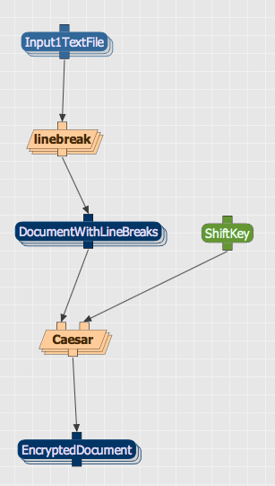
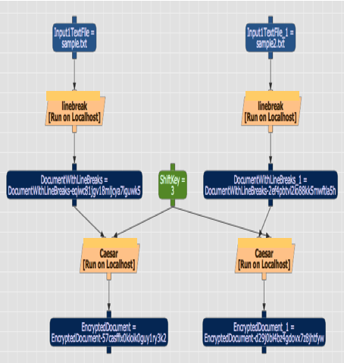
Automatic Processing of Multiple Inputs

Slide 30
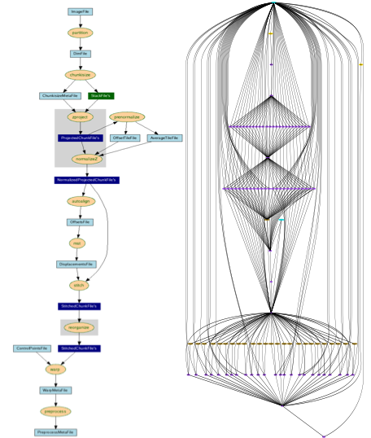
Large-Scale Data Processing

Slide 31


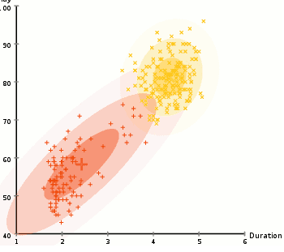

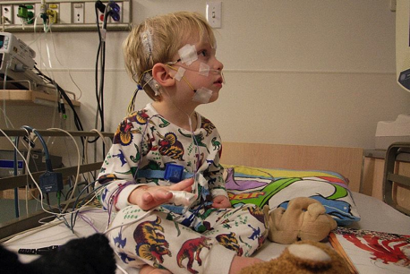

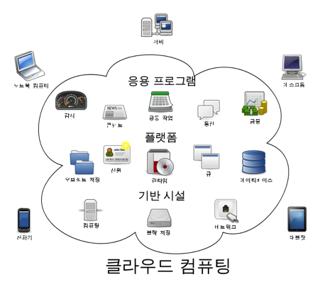


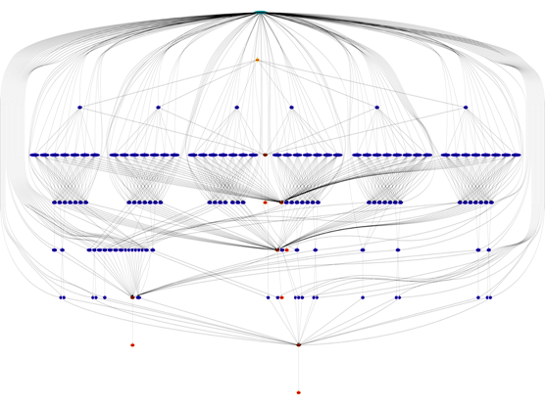
Facilitate Communication Across Data Science Expertise Areas
Domain knowledge
Statistics, data mining
Distributed systems
Large-Scale Data Processing

Slide 32







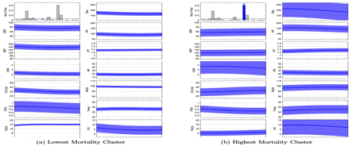
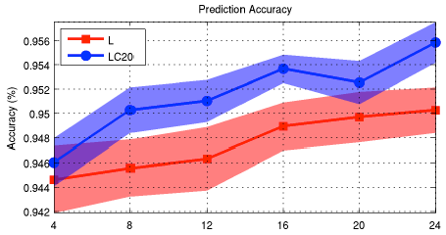


ICU Patient Clustering [Marlin et al IHI’12; Kale et al ‘13]
Describe problem
CODE
Provide data
Show results
Point out issues
Show more results

Slide 33
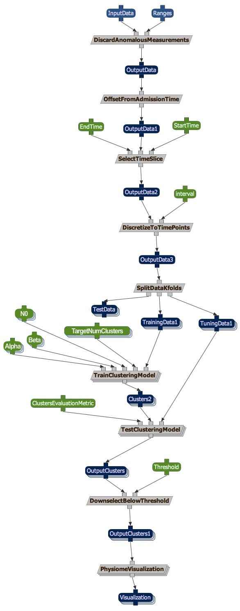
ICU Patient Clustering [Marlin et al IHI’12; Kale et al ‘13]
End users can easily and continuously explore the data by running the workflow themselves, trying out different data and different parameter values

Slide 34
RECAP: Benefits of Using Workflows
Simple programming paradigm
Modular assembly
Composing heterogeneous code
Abstraction
Data preparation steps
Data visualization steps
Documenting provenance: reproducibility
Automatic processing of multiple inputs
Large-scale processing
Facilitating communication across data science expertise areas
https://www.flickr.com/photos/genista/3432987963

Slide 35
4. Workflow Systems

Slide 36
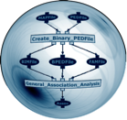

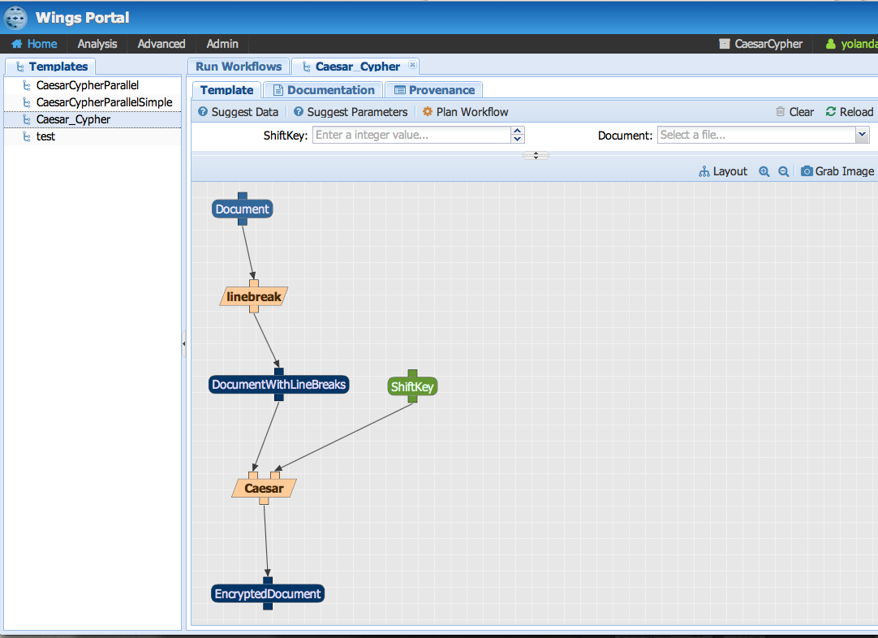
WINGS http://www.wings-workflows.org

Slide 37
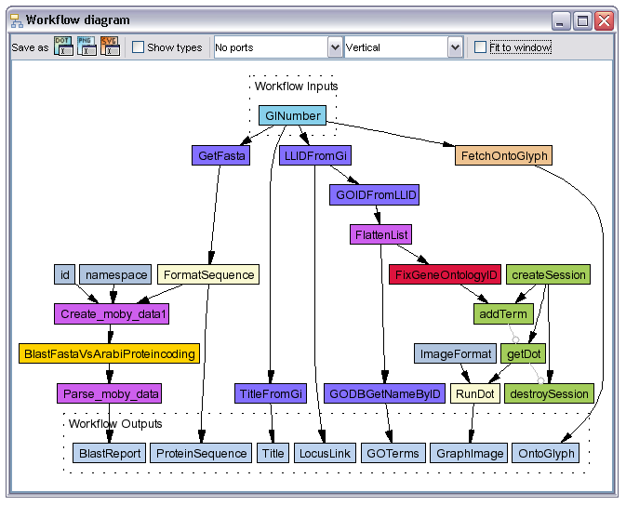
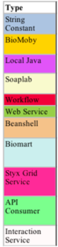
Taverna

Slide 38
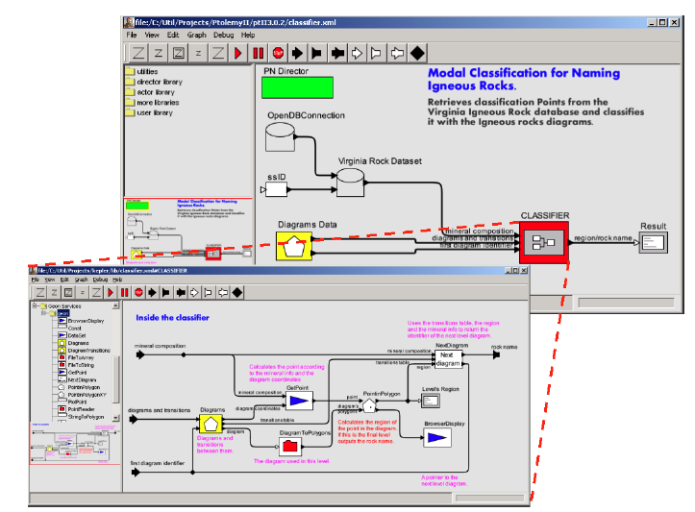
Kepler http://www.kepler-project.org

Slide 39

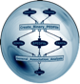

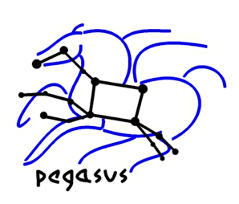










Workflow Systems
Many choices
Academic prototypes
Operational open source
Commercial
Each has different capabilities
Workflow validation
Scalable computations
Domain functions

Slide 40
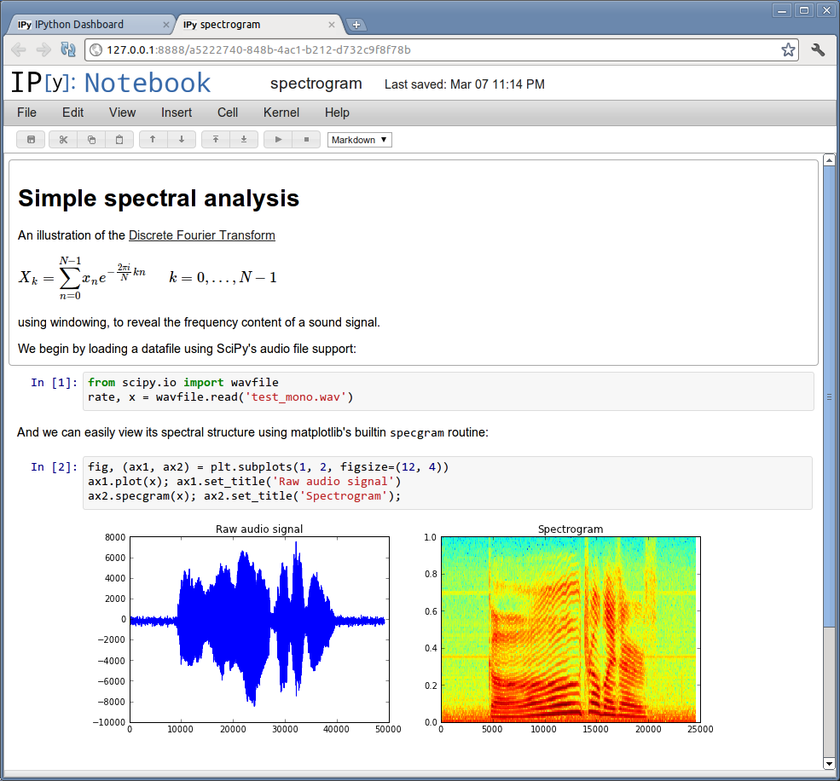
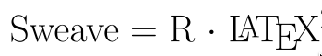

A Popular Alternative: Electronic Lab Notebooks
Record data, software, results, notes, etc.
Records what code was run when generating a result
Can re-run code with new data
http://ipython.org/notebook.html

Slide 41
Feature | Workflow systems | Electronic notebooks
Simple programming paradigm
Modular assembly
Composing heterogeneous codes
Abstraction
Data preparation steps
Data visualization steps
Documenting provenance
Automatic processing of multiple inputs
Large scale processing
Facilitating communication across data science expertise areas
✔
✗
✔
✗
✔
✗
✔
✗
✔
✔
✔
✔
✔
✔
(limited)
✔
✗
✔
✗
✔
✗

Slide 42
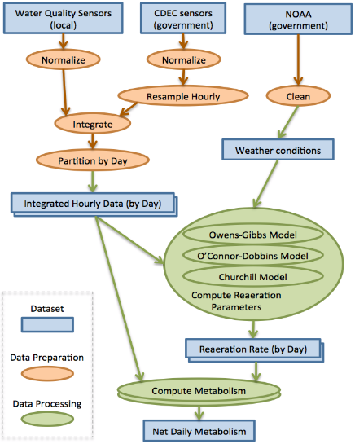
Developing Workflows: How to Sketch a Workflow
Compile the command line invocation to all your codes
Input data, parameters, configuration files
Include data preparation codes
Consider how the data flows from code to code
Starting with the input data, work your way to the results
If any steps were done with manual intervention, indicate that
Create subworkflows if it gets large

Slide 43

From a Workflow Sketch to a Formal Workflow

Slide 44
II. Provenance
Introduction to Computational Thinking and Data Science
Yolanda Gil
gil@isi.edu
October 2016

Slide 45
Provenance
Defining provenance
Data provenance
Representing provenance
Provenance in scientific articles

Slide 46


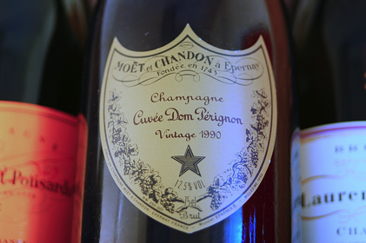
The Many Meanings of Provenance
A signature
A document
A method
http://commons.wikimedia.org/wiki/File:The_seal_of_National_Taiwan_University.png
https://www.flickr.com/photos/alterschwede08/3203630740/ (CC BY-ND 2.0)
http://www.imdb.com/title/tt0040416/

Slide 47
Defining Provenance

Slide 48
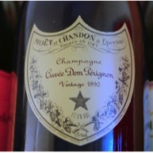


The Three Pillars of Provenance
1
3
2
Processes
Resources
Attribution
http://commons.wikimedia.org/wiki/File:The_seal_of_National_Taiwan_University.png
https://www.flickr.com/photos/alterschwede08/3203630740/ (CC BY-ND 2.0)
http://www.imdb.com/title/tt0040416/

Slide 49
1) Provenance as Process (Computing Steps, Actions, etc)

Slide 50
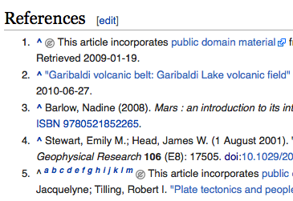
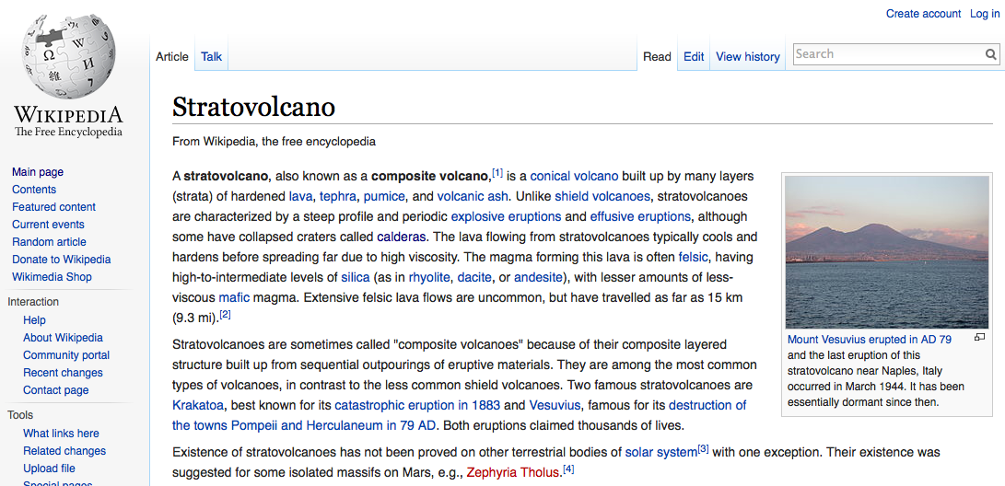
2) Provenance as Resources (Documents, Data, etc)

Slide 51
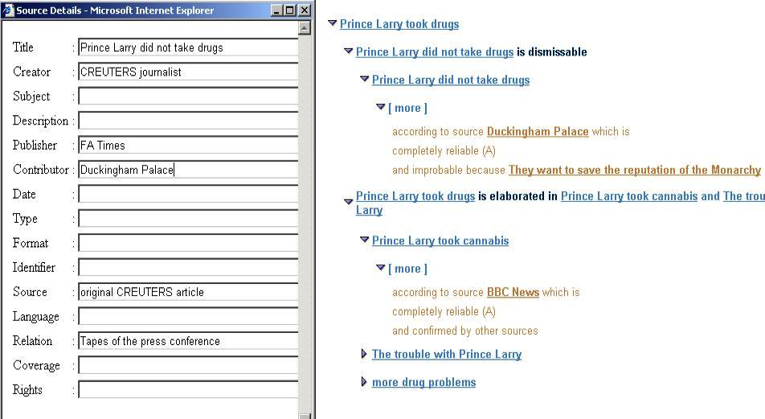
3) Provenance as Attribution (People, institutions, etc)
Ex: NY Times article from REUTERS
reporting “At a press conference last
Monday, Buckingham Palace was
adamant that Prince Larry did not inhale.“
Notes:
51

Slide 52
Defining Provenance
http://www.w3.org/2005/Incubator/prov/wiki/What_Is_Provenance
Provenance of a resource is a record that describes entities and processes involved in producing and delivering or otherwise influencing that resource.
Provenance provides a critical foundation for assessing authenticity, enabling trust, and allowing reproducibility.

Slide 53
Data Provenance

Slide 54
Data Provenance
Data provenance consists of one or more records that describe the entities and processes involved in:
Creating the data
How the data was generated
Delivering the data
What sources stored it and delivered it to a consumer
Provenance is key to understand what the data represents and how to use it properly
Provenance can be stored as metadata
But not all metadata is provenance (e.g. the size of a dataset)

Slide 55
Provenance of Data Collection
Create data
Instruments and sensors
Device type
Device settings
Surveys
Design
System instrumentation
Automatic recording of user or system actions
Find data
Source
Collection process
Frequency
Granularity
Recording process
Criteria for what to preserve
Process for what to preserve

Slide 56
Representing Provenance

Slide 57
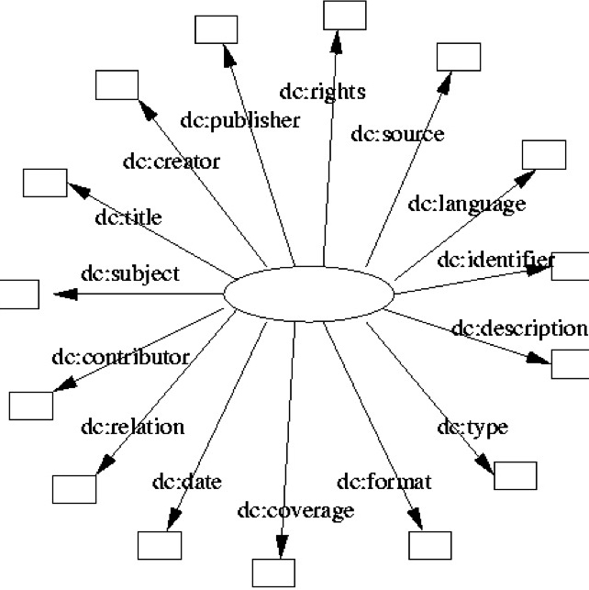
A Classic Provenance Representation: The Dublin Core
From library sciences
http://dublincore.org/documents/dcmi-terms/
http://dublincore.org/documents/dcq-rdf-xml/

Slide 58
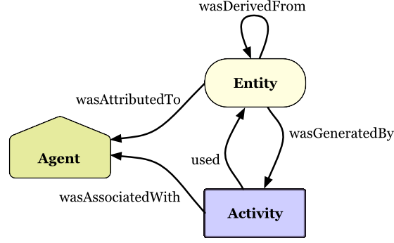
A Widely-Used Provenance Representation: The W3C PROV Standard
actedOnBehalfOf
http://www.w3.org/TR/prov-primer/

Slide 59
A Classic Provenance Representation: The Dublin Core
From library sciences
http://dublincore.org/documents/dcmi-terms/
http://dublincore.org/documents/dcq-rdf-xml/

Slide 60
A Widely-Used Provenance Representation: PROV
actedOnBehalfOf
http://www.w3.org/TR/prov-primer/

Slide 61
Provenance Scenario Overview
A blogger looking over an online newspaper article spots what she thinks to be an error in a chart that the article includes. The chart was produced by a chart generator company from a government agency dataset.
The blogger explores the provenance records for the article, which combine provenance provided by the newspaper, the chart generator company, and the government agency.
The provenance provided by each source uses a different prefix: exn, exc, and exg respectively.
http://www.w3.org/TR/prov-primer/

Slide 62
PROV Scenario (I): Entities
Entities are physical, digital, conceptual, or other kinds of things. Provenance records describe the provenance of entities, and an entity’s provenance may refer to many other entities.
An online newspaper publishes an article with a chart about crime statistics based on data provided by a government portal.
The article includes a chart based on the data, with data values composed (aggregated) by geographical regions.
http://www.w3.org/TR/prov-primer/

Slide 63
PROV Scenario (II): Activities
Activities are how entities come into existence and how their attributes change to become new entities, often making use of previously existing entities to achieve this.
There was an activity done by the chart agency (exc:compile1) denoting the compilation of the chart from the data set.
This activity includes more specific steps involved in this compilation, which are first composing the data by region (exc:compose1) and then generating the chart graphic (exc:illustrate1).
http://www.w3.org/TR/prov-primer/

Slide 64

PROV Scenario (III): Use and Generation
Activities generate new entities. Activities make use of entities.
The composition activity (exc:compose1) used the original data set, the list of regions. The composed data was generated by this activity.
Similarly, the chart graphic creation activity (exc:illustrate1) used the composed data, and the chart was generated by this activity.
http://www.w3.org/TR/prov-primer/

Slide 65

PROV Scenario (IV): Agents
An agent takes a role in an activity such that the agent can be assigned some degree of responsibility for the activity taking place. An agent can be a person, a piece of software, an organization, etc.
Betty sees that Derek was involved composing the data and creating the chart.
Derek is a person who works for an organization called ChartGen (Chart Generators).
http://www.w3.org/TR/prov-primer/

Slide 66
PROV Scenario (V): Revision and Derivation
An entity’s characteristics can derived from another one’s characteristics. An entity is revised when its charactistics change over time.
Betty looks at the dataset exg:dataset1, and sees that it is missing data from one of the zipcodes in the area. She contacts the government agency.
The government agency creates a new version of the dataset. The provenance of this new dataset, exg:dataset2, states that it is a revision of the old data set, exg:dataset1.
Derek notices that there is a new dataset available and creates a new chart exc:chart2 based on the revised data, using another compilation activity.
http://www.w3.org/TR/prov-primer/

Slide 67
Derivation as a Direct Link Between Entities
wasDerivedFrom

Slide 68

PROV Scenario (VI): Plans
An agent executing an activity may follow a pre-defined procedure, such as a recipe, a tutorial, an instruction set, or a workflow.
The correction was done by Edith (exg:edith) following clearly defined correction instructions (exg:instructions).
http://www.w3.org/TR/prov-primer/

Slide 69
Workflow Provenance In PROV

Slide 70
CLASS EXERCISE: Representing Provenance
Laura designs a survey about student financial support
Jack and Jill conduct the survey and collect data
A year later, Laura revises the survey
Peter and Paula conduct the survey and collect data
Zack compiles all the survey results, analyzes them with a statistics package, and publishes a paper with Laura and other co-authors
Entities
Activities
Use and generation
Agents
Revision and derivation
Plans

Slide 71
Provenance in Scientific Articles

Slide 72
Methods Described in Text Are Incomplete
Analysis of 18 quantitative papers published in Nature Genetics in the past two years found that reproducibility was not achievable even in principle in 10 cases, even when datasets are published [Ioannidis et al 09]
“Data processing, however, is often not described well enough to allow for exact reproduction of the results, leading to exercises in ‘forensic bioinformatics’ where aspects of raw data and reported results are used to infer what methods must have been employed.” [Baggerly and Coombes 09]

Slide 73
Methods Described in Text Are Ambiguous
“Ambiguity in program descriptions leads to the possibility, if not the certainty, that a given natural language description can be converted into computer code in various ways, each of which may lead to different numerical outcomes.” [Ince et al 2012]
“Ambiguity can occur at the lexical, syntactic or semantic level and is not necessarily the result of incompetence or bad practice. It is a natural consequence of using natural language and is unavoidable. ” [Ince et al 2012]

Slide 74


What the Paper Says Versus What the Actual Software Does (from [Garijo et al 2013])

Slide 75
Provenance in Scientific Articles
Typical Published Article
Article with full provenance
Text:
Narrative of method,
software packages used
Text:
Narrative of method,
software packages used
Data:
Key datasets and figures/plots
Data:
Key datasets and figures/plots
Software:
Scripts and codes
NOT published,
loosely recorded:
Workflow:
Workflow/scripts with
dataflow, codes, and parameters
Software/Workflow:
scripted codes + manual steps +
notes/emails

Slide 76
Example
Understanding kinematic data from
the Hellerman thrust zone
Jade Silverstein and Joseph Wilson
[…] We took a quartzite sample from the Hellerman thrust zone, and cut 3 thin sections. We measured c-axis orientations using a petrographic microscope. We rotated to a common reference frame using Duyster’s StereoNett program. We plotted the data on lower hemisphere, equal area projections using Duyster’s StereoNett program, shown in Figure 4. […]

Slide 77
Example: Sketch of the Workflow
Quartzite sample
Understanding kinematic data from
the Hellerman thrust zone
Petrographic microscope
measurements
Jade Silverstein and Joseph Wilson
C-axis orientations
[…] We took a quartzite sample from the Hellerman thrust zone, and cut 3 thin sections. We measured c-axis orientations using a petrographic microscope. We rotated to a common reference frame using Duyster’s StereoNett program. We plotted the data on lower hemisphere, equal area projections using Duyster’s StereoNett program, shown in Figure 4. […]
StereoNett Rotation
Common reference frame
StereoNett Plotting
Figure 4 plot

Slide 78
Example: Text and Provenance
Understanding kinematic data from
the Moine thrust zone (doi:10.1016/j.ess.2009.08.012)
Quartzite sample
IGSN: GMY00007W
Petrographic microscope
measurements
Jade Silverstein (orcid.org/0000-0001-8455-8431)
[…] We took a quartzite sample (IGSN: GMY00007W) from the Stack of Glencoul in the Moine thrust, and cut 3 thin sections. We measured c-axis orientations (doi:10.6084/m9.figshare.786887) using a petrographic microscope. We rotated to a common reference frame (doi:10.6084/m9.figshare.798887) using Duyster’s StereoNett program (doi:10.5281/zenodo.18954). We plotted the data on lower hemisphere, equal area projections (doi:10.6084/m9.figshare.798887) using Duyster’s StereoNett program (doi:10.5281/zenodo.18966), shown in Figure 4. The provenance is shown in Fig 5. […]
C-axis orientations
doi:10.6084/m9.figshare.786887
StereoNett Rotation
doi:10.5281/zenodo.18954
Common reference frame
doi:10.6084/m9.figshare.798887
StereoNett Plotting
doi:10.5281/zenodo.18966
Figure 4 plot
doi:10.6084/m9.figshare.798887

Slide 79
Formal Provenance
Quartzite sample
used
Petrographic microscope
measurements
wasAssociatedWith
wasGeneratedBy
Joseph Wilson
C-axis orientations
used
used
StereoNett Rotation
wasAssociatedWith
wasGeneratedBy
Jade Silverstein
Common reference frame
used
used
wasAssociatedWith
StereoNett Plotting
wasGeneratedBy
Figure 4 plot

Slide 80
Reproducibility through Provenance Recording
Repeatability: the same lab can re-run a (data analysis) method and get the same results
Not so obvious due to new versions of software, people forgetting what was done, people moving, etc.
Replication: another lab can re-run a (data analysis) method and get the same results
Original lab has to document in detail what was done
Reproducibility: another lab can run a (data analysis) method with different data (or run a different analysis method with the same data) and get consistent results
Reuse: another lab can run a (data analysis) method (or parts of it) for a different experiment

Slide 81
CLASS EXERCISE: Repeatability, Replication, Reproducibility, Reuse
“Researchers in Frankfurt have identified the genetic code of Monarch Butterfly following the identification of the genetic code of Drosophila done in Seoul last year.”
“Researchers in Rome produce a second mouse clone following an earlier announcement of a mouse clone”
“Researchers in Helsinki obtain new continental drift rates by adding precision to an earlier method developed in Lisbon”
“Researchers in Alaska corroborate the salinity index that researchers found in Canada during salmon season”

Slide 82
CLASS EXERCISE: Repeatability, Replication, Reproducibility, Reuse
“Researchers in Frankfurt have identified the genetic code of Monarch Butterfly following the identification of the genetic code of Drosophila done in Seoul last year.”
REPRODUCIBILITY
“Researchers in Rome produce a second mouse clone following an earlier announcement of a mouse clone”
REPEATABILITY
“Researchers in Helsinki obtain new continental drift rates by adding precision to an earlier method developed in Lisbon”
REUSE
“Researchers in Alaska corroborate the salinity index that researchers found in Canada during salmon season”
REPLICATION

Slide 83


What to Show in a Paper
Describe workflow in text, and provide a workflow sketch
Specify all software used (data pre-processing, visualization, etc) with command line invocations
Ideally, provide the formal workflow or lab notebook
Include a summary of the execution traces as supplementary material
Specify all input data, parameter values, and if possible all intermediate and final results
Ideally, include instead the provenance records using a standard like W3C PROV

Slide 84
Today’s Topics
Workflows
Computational workflows
Benefits of using workflows
Workflow systems

Slide 85
PRACTICUM
Using the WINGS
Workflow System
Introduction to Computational Thinking and Data Science
Yolanda Gil
gil@isi.edu
October 2016

Slide 86
The WINGS Workflow System
http://www.wings-workflows.org
http://www.wings-workflows.org/tutorial/workflowUser

Slide 87
Run Workflows: Specifying Input Data

Slide 88

Run Workflows: Selecting a Workflow to Run

Slide 89

Access Results

Slide 90

Manage Data: Browsing Data and Metadata

Slide 91

Manage Data: Uploading Files

Slide 92

Manage Domains

Slide 93

Manage Components: Browsing Components

Slide 94

Edit Workflows

